Slide 1

RFM CLUSTERING ON ONLINE RETAIL LISTING
UNSUPERVISED LEARNING
This Photo by Unknown Author is licensed under CC BY-NC

Slide 2




PROFILE
085704928504
linkedin.com/in/arenggadean
https://github.com/MBAHTAWOONS
Nama | Arengga Dean Prayoga, S.pt
Age | 25 Years (1998)
Occupation | Python User
Education Background
Bachelor degrees of Animal Husbandry (Brawijaya University, 2021)
Data Science Bootcamp (Dibimbing.ID, September 2023)

Slide 3

FLOW SLIDES
BUSSINESS UNDERSTANDING
DATA PREPARATION
EXPLORATORY DATA ANALYST
CLUSTERING

Slide 4

BUSSINESS UNDERSTANDING

Slide 5


ONLINE RETAIL (none store)
Online retail is a none store companies that sell retail products about unique gifts for customers (many customers are wholesaler)
RFM ANALYSIS
RFM Analysis is one of the methods used for customer segmentation. This is used in unsupervised learning based on customers Recency, Frequency, and Monetary in the sales record.
This method can be used for decisions on marketing and customers services

Slide 6

DATA PREPARATION

Slide 7
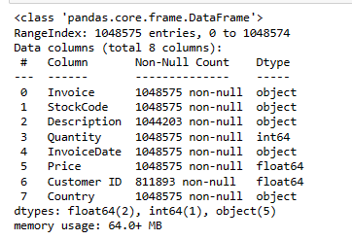
Dataset
Dataset: This Online Retail II data set contains all the transactions occurring for a UK-based and registered, non-store online retail between 01/12/2009 and 09/12/2011.The company mainly sells unique all-occasion giftware. Many customers of the company are wholesalers.
Entries = 1.048.575 entries
Features = 8 columns (customer information & product sales information)

Slide 8
CLEANING
Duplicated record:
34.150 rows duplicated (All column subset) from 104.8575 rows or 4%
Handle: Drop duplicated
Missing Value:
Customer ID :
228.826 rows missing from the customer ID column, about 22% of the data. it's a pity because it is a unique that can't be substituted.
Description:
4265 rows missing from the Description column, about 0,5 % from data.
Handle: Drop missing value from customer ID already drop all missing columns

Slide 9
FEATURING
RECENCY:
Based on how new customers do purchasing (last transaction)
Create : by column InvoiceDate (last transaction) difference days to data taken
FREQUENCY:
Based on how often customers do purchasing (Frequency of Invoice by unique customer)
Create : count of invoice by customerID unique
Monetary:
Based on how much customer spend money in purchasing
Create: total of total expend (price * quantity) each invoice by customer

Slide 10

EXPLORATORY DATA ANALYST

Slide 11
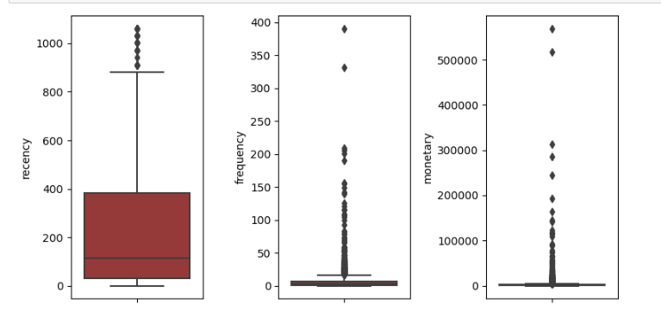
Univariate
Only recency shows not so much difference between values (outliers) indicates there is no difference in recency between each customer

Slide 12
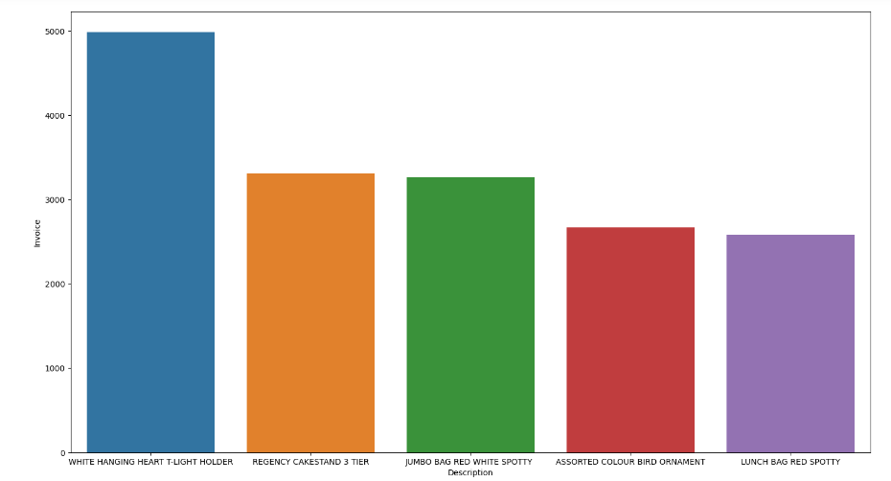
Top product all time
White Hanging Heart t-light holdem is the most Product get sale, even in each year from 2009-2011.
White Hanging Heart t-light holdem

Slide 13
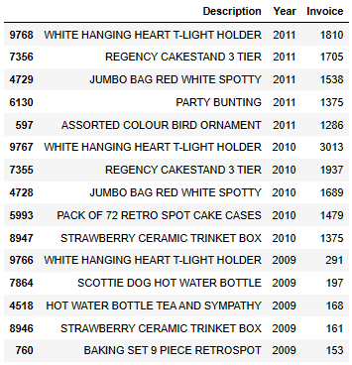
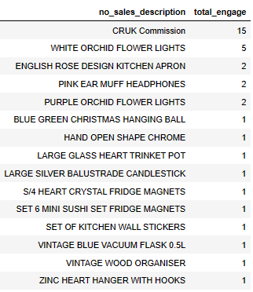
TOP 5 PRODUCT EACH YEAR
Waste product (never had sales)
2011
2010
2009
White hanging heart t-light holder is the most top product each year, and Regency Cakestand 3 tier and jumbo bag red white spotty sequence is in top 3 for last two years
15 description products never had sales for all records. And the most product gets engage by customers is only 15 times.

Slide 14

CLUSTERING

Slide 15
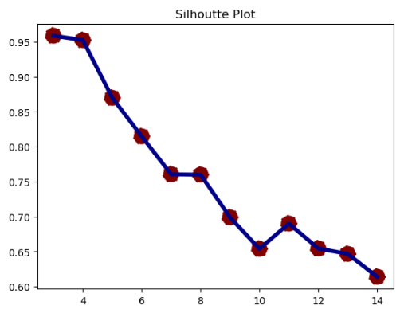
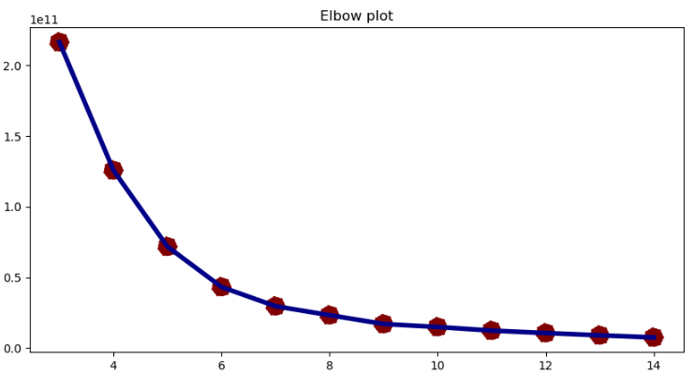
Cluster Determining
4 cluster
4 cluster
Cluster determine by using the Silhoutte score and the Elbow method using K-means model. After the model was tested 4 clusters were chosen.

Slide 16
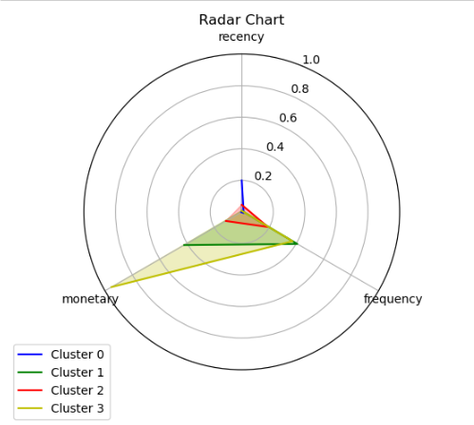
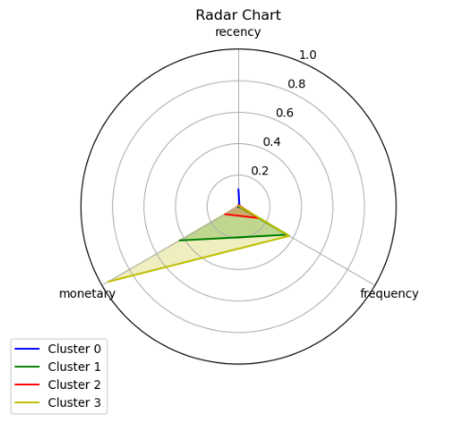
Cluster Radar Chart Visualization
Mean Cluster Value Plot
Median Cluster Value Plot
There is no Significant different values from the mean and median cluster plot

Slide 17




Segmentation
Based on 4 clusters created, segmentation between customers is:
Considered Customer
Customer half year average recency (more than 6 months), frequency very low (average 5 times), and monetary very low (average 2 thousand pound sterling, most of the customers in the record (5876 counts).
High Traffic Customer:
Customers that recency around a month ago (average 47 days), frequency often (average 74 Times), and monetary good (average 65.489 pound sterling), only a few customers (41 count).
Loyal Customer:
Customers that recency only a week ago, frequency very often (average 159 Times), and high monetary (average 240.120-pound sterling), only little customers (5 counts).
Partner Customer
Customer that recency around a week ago, frequency very often (average 145 Times), and very very high monetary (average 543.188 pound sterling), only 2 customers.

Slide 18
Recomendation
Gift call-back promos For Considered Customers, like discounts, and free service with conditions with the hope customers will retain or upgrade class.
Gift more promos for High Traffic customers with high discount value in specific products (Recommended wasted products and product top sales) and other discount conditions for sustaining customer purchase.
Gift Thanks Gift to loyal customers like notif card, present, or credit. To impress customers.
Gift early access to partner customers all products and thanks gift to impress customers.
Can do remove on wasted product for next stock, or give discount if the stock is many

Slide 19
THANK YOU
File to Download:
https://github.com/MBAHTAWOONS/RFM_UNSUPERVISED_ONLINE_RETAIL
Explore with Streamlit:
-

